Slide 1
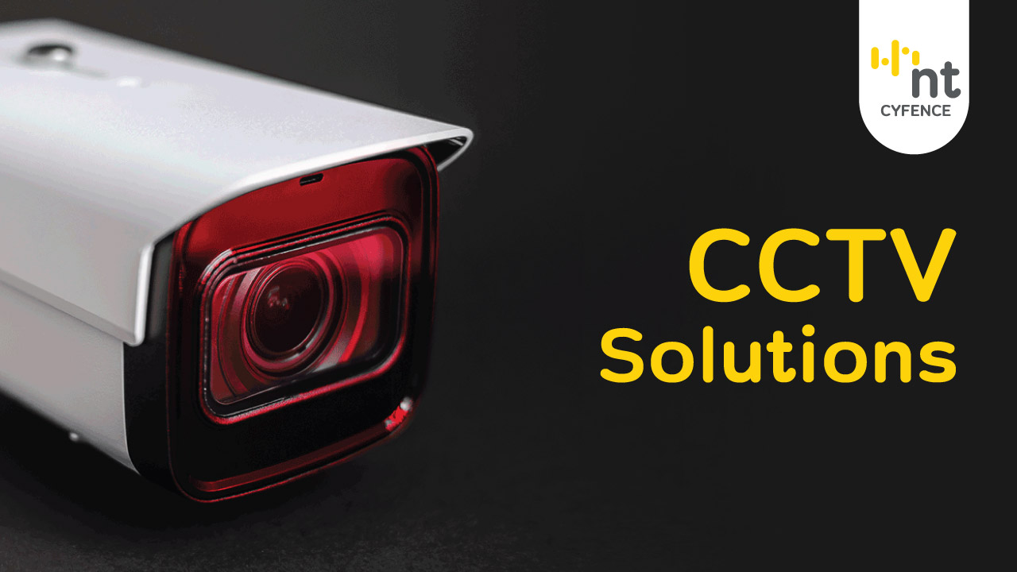
CCTV Solutions

